Slide 1

zomato
analysis
Analysis

Slide 2
P-102: Group No.6 1. Shagun Rana 2. Jayesh Ingale 3. Vivek Gupta 4. Abhishek Karande 5. Tejas P

Slide 3
Business Objective
Optimize restaurant operations
Improve customer experience
Increase profitability
Enhance decision-making
Drive competitive advantage

Slide 4
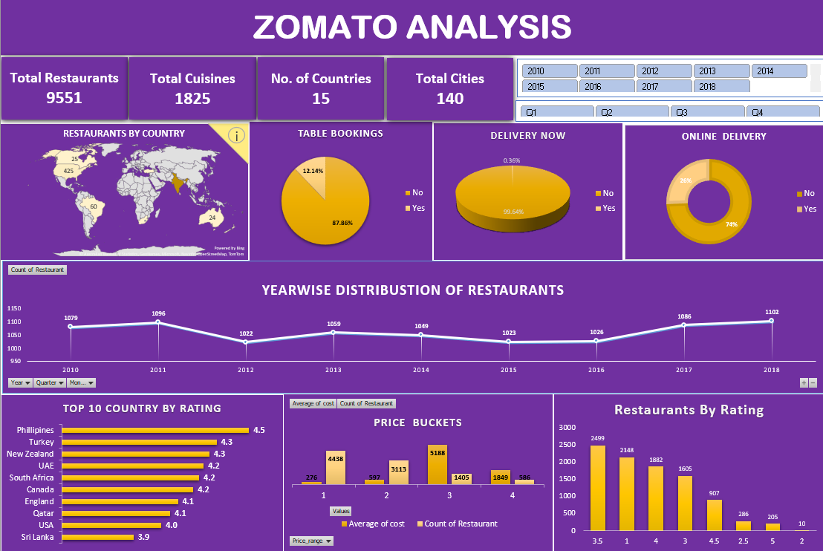
Excel Dashboard

Slide 5
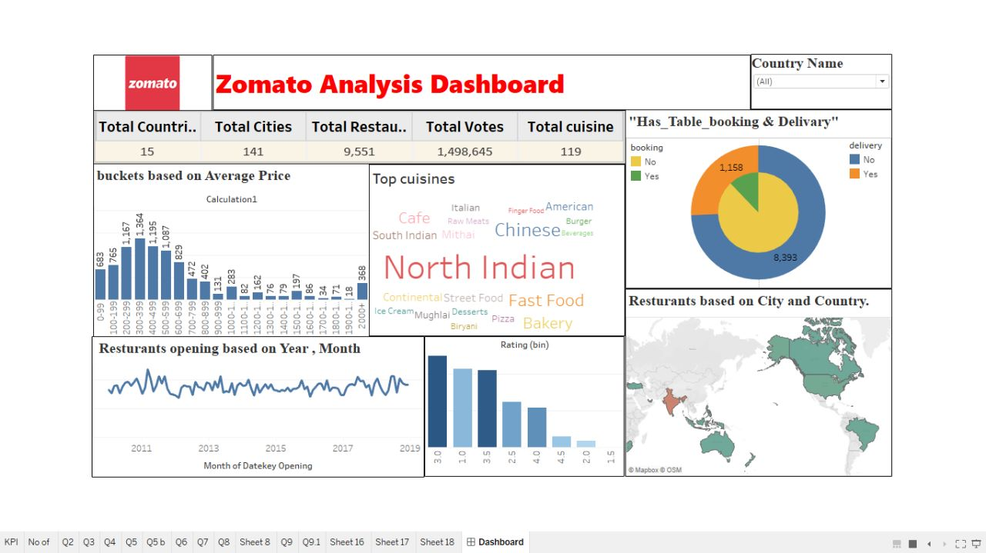
Tableau Dashboard

Slide 6
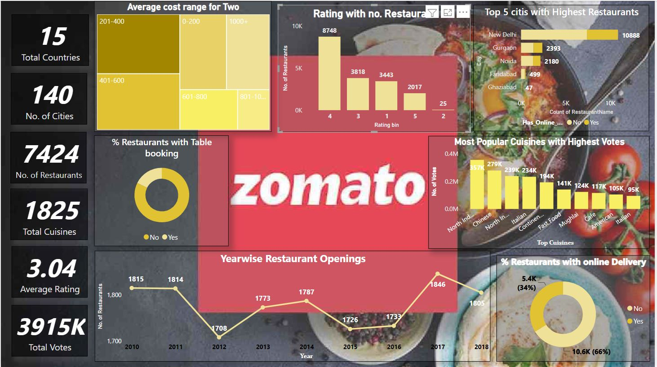
Power BI Dashboard

Slide 7
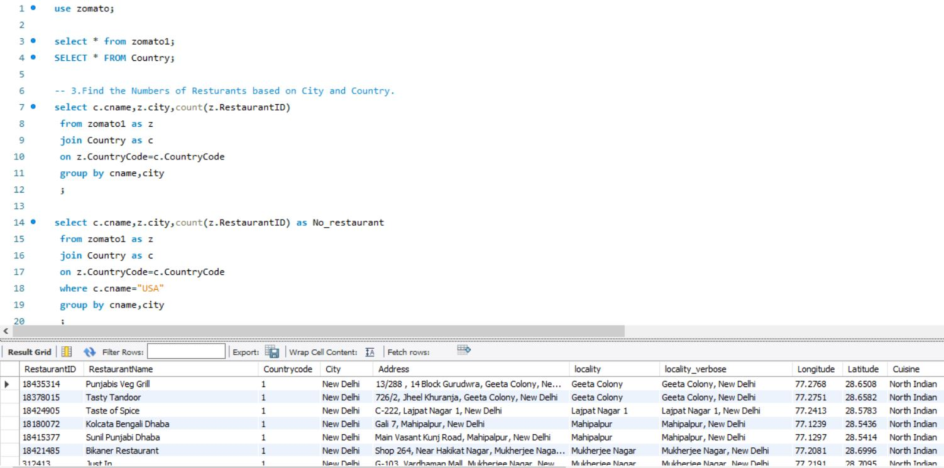
SQL

Slide 8
Thank You

